Slide 1

CS411-Compiler Construction
Top Down Parsing
-Recursive Descent Parsing
-Recursive Predictive Parsing
-Non-Recursive Predictive Parsing
Talha Waheed, Dept. of CS, UET, Lahore, Pakistan.

Slide 2
Course Learning Objectives

Slide 3
Top-Down Parsing
The parse tree of input string is created from top (root) to down (leaves) by expanding nodes in preorder (depth-first wise).
Or equivalently by finding a leftmost derivation for an input string

Slide 4
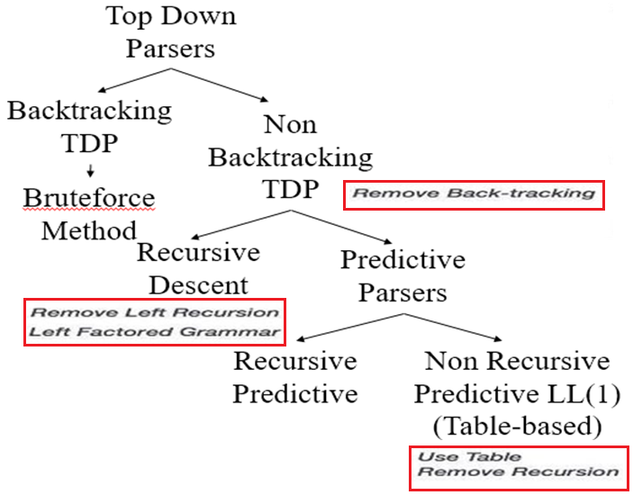
Top Down Parsing
For Recursive Descent parsers we need to eliminate left-recursion, left factoring, and ambiguity to make grammar LL(1).
Whereas Predictive parsers do not require backtracking
When replacing a non-terminal in a derivation step, a predictive parser can uniquely choose a production by just looking at the current input token.
if current token is terminal if we choose first rule, if it is while we choose second, etc. stmt → if ...... | while ...... | for .....

Slide 5
Recursive Descent Parsing

Slide 6
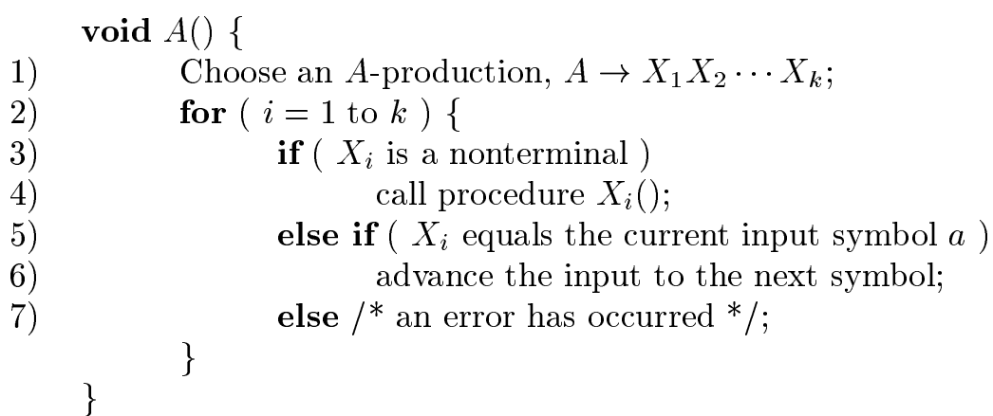
Recursive Descent Parsing
Grammar: A → X₁X₂X₃ | Y₁Y₂ | Z₁Z₂Z₃Z₄
Execution begins with the procedure for the start symbol (like A in this case),
Which halts and announces success if its procedure body scans the entire input string.
Pseudocode for a typical recursive-descent parser consists of a set of procedures, one for each nonterminal (line 4), and a match statement for each terminal (line 5)
Note that this pseudocode is nondeterministic, since it begins by choosing any of the A-productions to apply in a manner that is not specified.

Slide 7
Backtracking Recursive-Descent Parsing
General recursive-descent may require backtracking; it may require repeated scans over input.
Backtracking is rarely needed in programming languages parsers, so these are rare.
Even for natural language parsing, backtracking is not very efficient, and tabular methods such as dynamic programming algorithm or parsers like Earley’s algorithm are preferred.
To allow backtracking, the given pseudocode needs to be modified.
First, we cannot choose a unique A-production (out of A → X₁X₂X₃ | Y₁Y₂ | Z₁Z₂Z₃Z₄) at line (1), so we must try each of several productions in some order.
Error at line (7) is not ultimate failure, but suggests only that we need to return to line (1) and try another A-production. Error occurs if no more A-productions to try then we declare, an input error has been found.
In order to try another A-production, we need to be able to reset the input pointer to where it was when we first reached line (1). A local variable is needed to store this input pointer for future use.

Slide 8
Recursive-Descent Parsing (uses Backtracking)
While parsing sometime Backtracking is required.
It tries to find the left-most derivation, sequentially.
Grammar: S → cAd (1.1) A → (2.1) ab | a (2.2)
input:
input symbol at start.
maintain a local variable
at current input symbol
for backtracking e.g. at A. S S
c A d c A d
a b a
c | a | d
S ⇒ cAd ⇒ cabd
1st attempt fails, backtrack.
S ⇒ cAd ⇒ cad
2nd attempt, Successful!

Slide 9
Top Down Parsing
Recursive-Descent Parsing
Backtracking is needed (If a choice of a production rule does not work, we backtrack to try other alternatives.)
Not efficient
It is a general parsing technique, but not widely used.
Predictive Parsing
No backtracking
Efficient
Needs a special form of grammars (LL(1) grammars).
Recursive Predictive Parsing is a special form of Recursive Descent parsing without backtracking.
Non-Recursive (Table Driven) Predictive Parser is also known as LL(1) parser.

Slide 10
Predictive Parsing

Slide 11

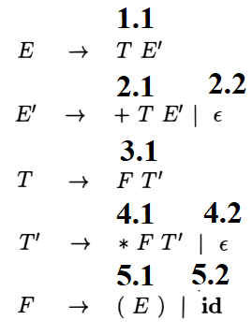

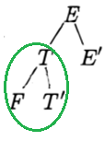
Example – Predictive Parsing
Parse the input string id + id * id by using the grammar (given in Box)
Input:
Current pointer
Use start symbol E to initiate parse tree generation
E can be replaced with only option E → TE’ (1.1)
Now which non-terminal to replace T or E’?
T can be replaced with only T → FT’ (3.1)
id | + | id | * | id

Slide 12
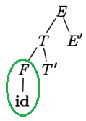
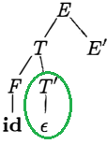
Example – Predictive Parsing
input:
current pointer
F can be replaced with 5.1 (F → (E) ) and 5.2 (F → id), which one to choose and why?
String generated: id
input:
current pointer?
T’ can be replaced with 4.1 (T→*FT’) and 4.2 (T’→ ε), which one to choose and why?
id | + | id | * | id
id | + | id | * | id

Slide 13
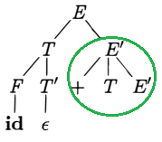
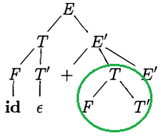
Example – Predictive Parsing
input:
Current pointer
To expand E’ try production 2.1 (E’→ +TE’)
String generated: id +
To Expand T only option is (T→FT’)
id | + | id | * | id

Slide 14
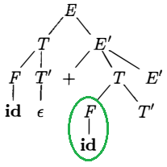
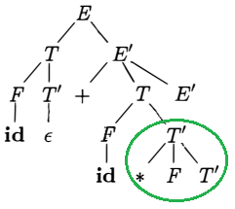
Example – Predictive Parsing
input:
current pointer
To expand F try 5.2 (F → id)
String generated: id + id
input:
current pointer
To expand T’ try 4.1(T’ → *FT’)
String generated: id + id *
id | + | id | * | id
id | + | id | * | id

Slide 15
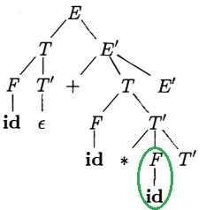
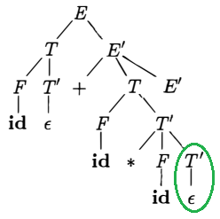
Example – Predictive Parsing
input:
Current pointer
To expand F try (F → id)
String generated: id + id * id
To expand T’ try 4.2 (T’ → ε)
id | + | id | * | id

Slide 16
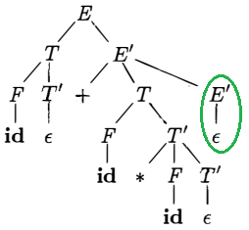
Example – Predictive Parsing
input:
current pointer at end of string
To expand E’ try 2.2 (E’→ ε)
String matched with input.
No more non-terminal to expand.
Successfully. Halt!
id | + | id | * | id

Slide 17
Recursive Predictive Parsing
For each non-terminal write a function call
For each terminal write a match statement.
When replacing a non-terminal in a derivation step, a predictive parser can uniquely choose a production by just looking at the current input token
Grammar with one production: A → aBb
A() { match the current token with a, and move to the next token;
B();
match the current token with b, and move to the next token; }
Execution begins with the function call for the start symbol in main, it halts if entire input string is consumed, announce success.
main() {
A();
cout << “Parsing successfully completed”;
}

Slide 18
Recursive Predictive Parsing (cont.)
Grammar with two productions: A → aBb | bAB
A()
{
switch(current token) {
case ‘a’: match the current token with a, and move to the next token;
B();
match the current token with b, and move to the next token;
case ‘b’: match the current token with b, and move to the next token;
A();
B();
Default: error();
}
}

Slide 19
Recursive Predictive Parsing (cont.)
Grammar with ε-productions: A → aA | bB | ε
If all other productions fail, we should apply an ε-production. E.g., if the current token is not a neither b, we may apply the ε-production.
Most correct choice: We should apply an ε-production for a non-terminal A when the current token is in the follow set of A.
Now identify which terminals can follow A in the sentential forms?
will discuss follow set in detail later.

Slide 20
Recursive Predictive Parsing (Example)
Grammar with ε-productions: A → aBe | cBd | C B → bB | ε C → f
B() {
switch (current token) {
case b: match the current token with b, and move to the next token;
B();
case e, d: do nothing // e, d in follow set of B } }
C() {
match the current token with f,
and move to the next token; }
A(){
switch (current token) {
case a: match the current token with a,
and move to the next token;
B(); match the current token with e,
and move to the next token;
case c: match the current token with c, and move to the next token;
B();
match the current token with d, and move to the next token;
case f: C(); // f is in first set of C
}
}

Slide 21
Recursive Predictive Parsing – C Code Example
Grammar: S → z | Az A → xA | B B → y
void S() {
if (ch == ’z’) //match
{ ch = getchar();} //next char
else {
A();
if (ch == ’z’)
{ ch = getchar(); }
else
error("z expected");
}
cout << "Success!";
}
void A() {
if (ch == ’x’) {
ch = getchar();
A();
}
else B();
}
void B() {
if (ch == ’y’)
{ ch = getchar();}
else
error("y expected");
}

Slide 22
Non-Recursive Predictive Parsing (Table Driven)

Slide 23
Non-recursive Predictive Parsing
Non-Recursive predictive parser is a table-driven top-down parser.
It is also known as LL(1) Parser, due to LL(1) grammar.
It contains an explicit stack, rather than implicitly via recursive calls (as done in recursive predictive parsing).
The key problem is of predicting a production to be applied for a non-terminal.
It is easy to implement manually.

Slide 24
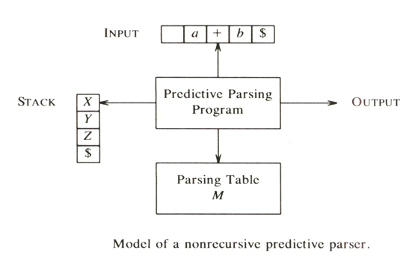
Model of LL(1) or Non-recursive Predictive Parser

Slide 25
LL(1) Parser
input buffer
Contains the string to be parsed. {assume it has end marker of $}
output
a production representing a step of the (left-most) derivation sequence of the string in the input buffer.

Slide 26
LL(1) Parser
stack
contains the grammar symbols {i.e. terminals and non-terminals}
at the bottom of the stack, there is a special end marker symbol $.
initially the stack contains only the symbol $ and starting symbol (e.g. S) of the grammar. $S ⬅ initial stack
when the input is finished and stack is empty, (i.e. only $ left in input and stack), the parsing is complete.

Slide 27
LL(1) Parser
parsing table
It is a two-dimensional array PT [A, a] where
each row is a non-terminal symbol
each column is a terminal symbol or the special symbol $
each entry holds only single production of Grammar.
What if it contains multiple entries?

Slide 28
Non-recursive Predictive Parsing Algorithm
(Where X = stack top symbol, a = current input symbol)
If X is a terminal
If X = a ≠ $ then pop X from stack and advance input pointer (Terminal Matched), If X ≠ a then error() (mismatch occured)
If X is non-terminal then consult parsing table PT.
If PT[X, a] contains a production of the form X → α then pop X and replace it with the symbols in α with leftmost on top of stack. (e.g. for X → WVU, W will be on top)
If PT[X, a] is empty (no production in table) or contains error entry, call error().
If X = a = $ then halt and announce success. (Stack and input both empty. Accept!)

Slide 29
LL(1) Parsing Table – Example1
Grammar: S → aBa B → bB | ε
Parsing Table
 | a | b | $
S | S → aBa
B | B → ε | B → bB
{where non-terminals S, B are in rows and terminals a, b, $ are in columns}

Slide 30
LL(1) Parsing Table – Example1
Grammar: S → aBa B → bB | ε
 | a | b | $
S | S → aBa
B | B → ε | B → bB
Parsing Table→
Input: abba$
parse tree
S
stack input output (action)
$S abba$ S → aBa (replace S)
$aBa abba$ match a
$aB bba$ B → bB (replace B)
$aBb bba$ match b
$aB ba$ B → bB (replace B)
$aBb ba$ match b
$aB a$ B → ε (replace B)
$a a$ match a
$ $ both empty. Accept!!
a
B
a
b
B
b
B
ε
Leftmost Derivation: S ⇒ aBa ⇒ abBa ⇒ abbBa ⇒ abba

Slide 31
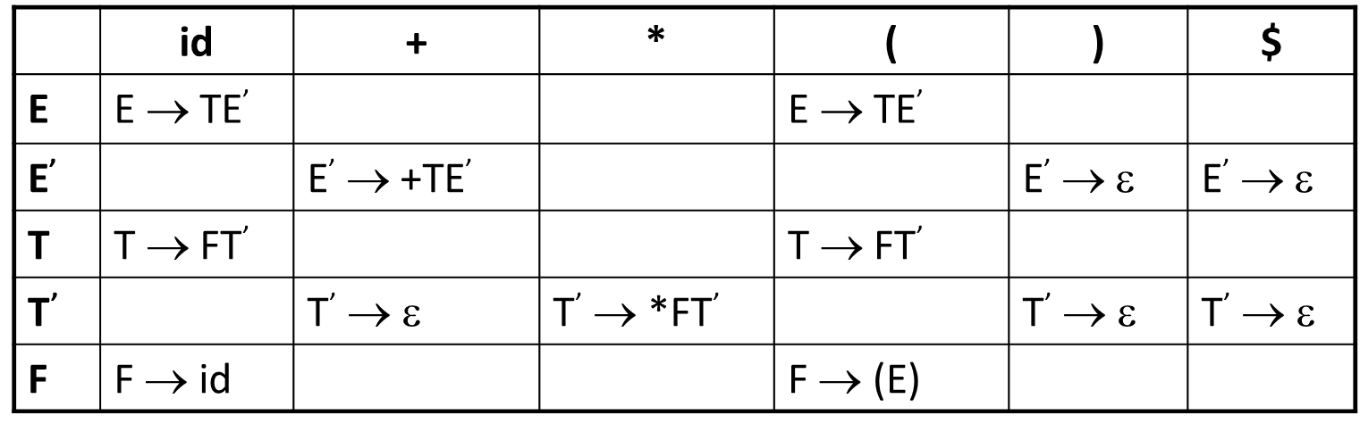
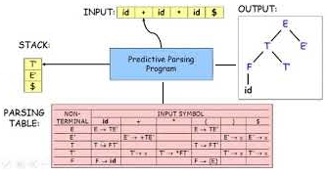
LL(1) Parser – Example2
Parsing Table →
Grammar:
E → TE’
E’ → +TE’ | ε
T → FT’
T’ → *FT’ | ε
F → (E) | id
Input 1: id + id$
Input 2: id++$ (Exercise)
stack input output (action)
$E id + id$ E → TE’
$E’T id + id$ T → FT’
$E’ T’F id + id$ F → id
$ E’ T’id id + id$ match id
$ E’ T’ + id$ T’ → ε
$ E’ + id$ E’ → +TE’
$ E’ T+ + id$ match +
$ E’ T id$ T → FT’
$ E’ T’ F id$ F → id
$ E’ T’id id$ match id
$ E’ T’ $ T’ → ε
$ E’ $ E’ → ε
$ $ both empty. Accept

Slide 32
Constructing LL(1) Parsing Tables
Following two sets are required for the construction of LL(1) parsing tables:
FIRST
FOLLOW
During topdown parsing (particularly in non-recursive predictive parsing), FIRST and FOLLOW allow us to choose which production to apply, based on the next input symbol.
FIRST and FOLLOW are also used in LR bottom up parsing technique (Will see later) .
Sets of tokens produced by FOLLOW can be used as synchronizing tokens, during panic-mode error recovery. (Will see later)

Slide 33
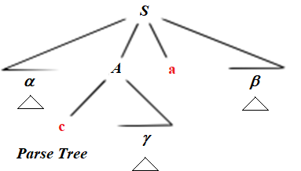
First (α) - Definition
FIRST(α), (where α is any string of grammar symbols), to be the
set of terminals which occur as first symbols in all strings derived from α.
If α ⇒ ε, then ε is also in FIRST(a).
e.g. for given grammar S → αAaβ A→cγ D→d (where α, β, γ are any strings of terminals, non-terminals and/or ε)
FIRST(A)={c}. (as shown in Parse Tree)
FIRST(D)={d}
What is FIRST(S)? (if α is a terminal d, non-terminal D, or ε)
FOLLOW(A) = {a} (as shown in Parse Tree)
*

Slide 34
Algorithm - FIRST SET for Any String X
To compute FIRST(X) for all grammar symbols X, apply following rules until no more terminals or ε can be added to any FIRST set.
If X is a terminal then FIRST(X) = {X}
If X→ ε is a production then add ε to FIRST(X)
If X is a non-terminal and X → Y₁Y₂…Y_{k} is a production then
If a terminal a is in FIRST(Y_{i}) and ε is in all FIRST(Y_{j}) for j = 1,..., i-1 then - add a in FIRST(X).
If ε is in FIRST(Y_{j}) for all j = 1, …, k then - add ε to FIRST (X)
e.g. in the production X → Y₁Y₂…Y_{k} Everything in FIRST(Y₁) is surely in FIRST(X). If Y₁ does not derive ε then we add nothing more to FIRST(X), but if Y₁ produced ε then we add FIRST(Y₂) and so on.

Slide 35
FIRST SET Example
Algorithm
If X is a terminal then FIRST(X) = {X}
If X→ ε is a production then add ε to FIRST(X)
If X is a non-terminal and X → Y₁Y₂…Y_{k} is a production then If a terminal a is in FIRST(Y_{i}) and ε is in all FIRST(Y_{j}) for j = 1,..., i-1 then - add a in FIRST(X). If ε is in FIRST(Y_{j}) for all j = 1, …, k then - add ε to FIRST (X)
Grammar:
E→TE’ E’→+TE’ | ε T→FT’ T’→*FT’ | ε F→(E) | id
FIRST(F) = {(, id}
FIRST(T) = {(, id}
FIRST(E) = {(, id}
FIRST(E’) = {+, ε}
FIRST(T’) = {*, ε}

Slide 36
Algorithm - FOLLOW SET (for non-terminals)
To compute FOLLOW(A) for all nonterminals A, apply these rules until nothing can be added to any follow set.
Place $ in FOLLOW(S), where S is the start symbol and $ is input right end marker.
if A → αBβ is a production (where α, β is a string of terminals and non-terminals) ➔ put everything in FIRST(β) into FOLLOW(B) except ε
If (A → αB is a production) or (A → αBβ is a production and ε is in FIRST(β) ) ➔ put everything in FOLLOW(A) into FOLLOW(B). E.g. xAy → xαBy
Grammar:
E→TE’ E’→+TE’ | ε T→FT’ T’→*FT’ | ε F → (E) | id
FIRST(F)=FIRST(T)=FIRST(E)= {(, id} FIRST(T’) = {*, ε} FIRST(E’) = {+, ε}
FOLLOW(E) = { $, ) } (rule 1, 2)
FOLLOW(E’) = { $, ) } (rule 3)
FOLLOW(T) = { +, $, ) } (rule 2, 3)
FOLLOW(T’) = {FOLLOW(T)} = { +, $, ) } (rule 3)
FOLLOW(F) = {*, FOLLOW(T)} = {*, +, $, ) } (rule 2, 3)

Slide 37
Parsing Table

Slide 38
Algorithm - LL(1) Parsing Table Construction
For each production A → α of the grammar do the following
for each terminal a in FIRST(α) - add A → α to PT[A, a]
If ε in FIRST(α) - for each terminal b in FOLLOW(A) add A → α to PT[A, b] If ε in FIRST(α) and $ in FOLLOW(A) - add A → α to PT[A, $] as well.
(All other undefined entries of the parsing table are error entries)

Slide 39
Example 1 - Constructing LL(1) Parsing Table
E → TE’ (1.1)
E’ → +TE’ (2.1) | ε (2.2)
T → FT’ (3.1)
T’ → *FT’ (4.1) | ε (4.2)
F → (E) (5.1) | id (5.2)
FIRST(F) = {(, id}
FIRST(T) = {(, id}
FIRST(E) = {(, id}
FIRST(T’) = {*, ε}
FIRST(E’) = {+, ε}
FOLLOW(E) = { $, ) }
FOLLOW(E’) ={ $, ) }
FOLLOW(T) = { +, ), $ }
FOLLOW(T’) ={ +, ), $ }
FOLLOW(F) ={+, *, ), $}
Algorithm
For each production A → α of the grammar do the following
for each terminal a in FIRST(α) - add A → α to PT[A, a]
If ε in FIRST(α) - for each terminal b in FOLLOW(A) add A → α to PT[A, b] If ε in FIRST(α) and $ in FOLLOW(A) - add A → α to PT[A, $] as well.
(All other undefined entries of the parsing table are error entries)

Slide 40
Example 1 - Constructing LL(1) Parsing Table
Production First Production(s) added into Parsing Table
F → (E) FIRST(F)={(} Add F → (E) at PT[F, (]
F → id FIRST(F)={id} Add F → id at PT[F, id]
T → FT’ FIRST(T)={(, id} Add T → FT’ at PT[T, (] and PT[T, id]
E → TE’ FIRST(E)={(, id} Add E → TE’ at PT[E, (] and PT[E, id]
E’ → +TE’ FIRST(E’ )={+} Add E’ → +TE’ at PT[E’,+]
E’ → ε FIRST(E) = {ε} since ε is in FIRST(E’)
and FOLLOW(E’)={), $} Add E’→ ε at PT[E’, )] and PT[E’, $]
T’ → *FT’ FIRST(T’ )={*} Add T’ → *FT’ at PT[T’, *]
T’ → ε FIRST(T’)={ε} since ε is in FIRST(T’)
and FOLLOW(T’)={+, ), $} Add T’→ ε at PT[T’, +], PT[T’, )], PT[T’, $]

Slide 41
Properties of LL(1) Grammars
A grammar is LL(1) if and only if the following conditions hold for two distinctive production rules A → α | β
Both α and β cannot derive strings starting with same terminals.
First(α) and First(β) must be distinct.
At most one of α and β can derive to ε. (To avoid non-determinism.)
If β can derive to ε, then α cannot derive to any string starting with a terminal in FOLLOW(A). S → Ay A → yC | ε where Follow(A) = {y}

Slide 42
Example 2 - Parsing Table for a non LL(1) Grammar of Dangling Else
Grammar:
S → if C then S E | a
E → else S | ε
C → b
FIRST(S) = {if, a}
FIRST(E) = {else, ε}
FIRST(C) = {b}
FOLLOW(S) = { $, else }
FOLLOW(E) = { $, else }
FOLLOW(C) = { then }
 | a | b | else | if | then | $
S | S → a |  |  | S → if C then S E
E |  |  | E → else S E → ε |  |  | E → ε
C |  | C → b
Two production rules for PT [E, else]??
Problem is ambiguity
Resolved by preferring E→else S (closest if)
The parsing table of a grammar may contain more than one production rule. In this case, we say that it is not a LL(1) grammar.

Slide 43
A Grammar which is not LL(1) (cont.)
If a grammar is left recursive it cannot be LL(1) grammar.
A → Aα | β
any terminal that appears in FIRST(β) also appears in FIRST(Aα) because Aα ⇒ βα.
If β is ε, any terminal that appears in FIRST(α) also appears in FIRST(Aα) and in FOLLOW(A).
If a grammar is not left factored, it cannot be LL(1) grammar
A → αβ₁ | αβ_{2,} any terminal that appears in FIRST(αβ₁) also appears in FIRST(αβ₂).
Similarly any ambiguous grammar cannot be LL(1) grammar.
What to do it if the resulting parsing table contains multiply defined entries?
Eliminate the left recursion in the grammar (if not already).
Left factor the grammar (if not already).
If (new grammar’s) parsing table still contains multiple entries, that grammar
is either ambiguous or
it is inherently not LL(1) grammar.

Slide 44
Example 3 - LL(1) Parser (Exercise – Make its Parsing Table)
Grammar
B → T B’
B’ → or T B’ | ε
T → F T’
T’ → and F T’ | ε
F → not F | ( B ) | true | false
Check is grammar LL(1)?
Left Factor
Left Recursion
Ambiguity Resolution
Calculate
First
Follow
Construct Parsing Table

Slide 45
Error Handling in Non-Recursive Predictive Parsing *
(*These techniques can be applied on recursive descent parsing as well, with minor modifications)
An error may occur in the predictive parsing (LL(1) parsing)
Terminal Mismatch
if terminal on the top of stack does not match with the current input symbol
Empty Entry in Parsing Table
if top of stack is a non-terminal B, current input is a, but parsing table entry PT[B, a] is either empty or error.

Slide 46
Panic-Mode Error Recovery in LL(1) Parsing
Skip all the input symbols until a synchronizing token is found.
Its effectiveness depends on the choice of synchronizing (sync) set.
The sets should be chosen so that the parser recovers quickly from errors.

Slide 47
Some Heuristics for Sync – What may be the sync token?
Place all the terminals in follow(A) into sync set for that non-terminal A. If we skip tokens until an element of FOLLOW(A) is seen and pop A from the stack, it is likely that parsing can continue.
add keywords that begin statements to the synchronizing sets for the nonterminals generating expressions.
If we add symbols in FIRST(A) to the synchronizing set for nonterminal A, then it may be possible to resume parsing according to A if a symbol in FIRST(A) appears in the input
If a nonterminal can generate the empty string, then the production deriving epsilon can be used as a default. Doing so may postpone some error detection, but cannot cause an error to be missed. This approach reduces the number of non-terminals that have to be considered during error recovery.
If a terminal on top of the stack cannot be matched, a simple idea is to pop the terminal, issue a message saying that the terminal was inserted, and continue parsing. In effect, this approach takes the synchronizing set of a token to consist of all other tokens.

Slide 48
Panic-Mode Error Recovery in LL(1) Parsing
All the empty entries are marked as sync to indicate that the parser will skip all the input symbols until a symbol in the follow set of the non-terminal A appears which is on the top of the stack. Then the parser will pop that non-terminal A from the stack. The parsing continues from that state.
To handle unmatched terminal symbols, the parser pops that unmatched terminal symbol from the stack and it issues an error message saying that that unmatched terminal is inserted.

Slide 49
Panic-Mode Error Recovery - Example
S → AbS | e | ε
A → a | cAd
FOLLOW(S)={$}
FOLLOW(A)={b, d}
Input 1: aab$
Input 2: ceadb$
 | a | b | c | d | e | $
S | S → AbS | sync | S → AbS | sync | S → e | S → ε
A | A → a | sync | A → cAd | sync | sync | sync
stack input output
$S aab$ S → AbS
$SbA aab$ A → a
$Sba aab$ match a, pop a, advance input
$Sb ab$ Error b inserted: pop b
$S ab$ S → AbS
$SbA ab$ A → a
$Sba ab$ match a, pop a, advance input
$Sb b$ match b, pop b, advance input
$S $ S → ε
$ $ Accept!!
stack input output
$S ceadb$ S → AbS
$SbA ceadb$ A → cAd
$SbdAc ceadb$ match c, pop c, advance input
$SbdA eadb$ Error:unexpected e (illegal A)
(Remove all input tokens until first b or d, pop A)
$Sbd db$ match d, pop d, advance input
$Sb b$ match b, pop b, advance input
$S $ S → ε
$ $ Accept!!

Slide 50
Phrase-Level Error Recovery
Each empty entry in the parsing table is filled with a pointer to a special Error() functions which will take care of that error case.
These Error() functions may:
change, insert, or delete input symbols.
issue appropriate error messages, and error locations to user
pop items from the stack (if required).
Design Error() functions carefully, because they can
put the parser into an infinite loop
derive no string of language at all or
introduce new errors.
To avoid above issues, check that any recovery action eventually results in
either an input symbol being consumed
or the stack being shortened if the end of the input has been reached
 | a | b | c | d | e | $
S | S → AbS | Error() | S → AbS | Error() | S → e | S → ε
A | A → a | Error() | A → cAd | Error() | Error() | Error()

